Slide 1
Game Spinner
Mission 9

Slide 2

Pre-Mission Preparation
In the last mission, you learned about random numbers.
Other than a game, give an example of when you might want to select a random person.

Slide 3
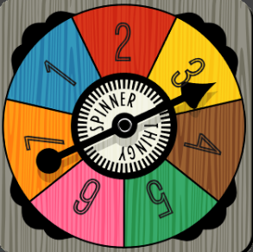
Mission 9: Game Spinner
In this project you will make a game spinner that can:
Choose the next person to answer a question
Select a path to take in a maze
Decide which pizza slice to eat
Be a spinner for a game
And anything else you can think of!

Slide 4

Objective #1: Random arrow
Review getting a random number from Mission 8. You will use the random number to display an arrow from the predefined list: pics.ALL_ARROWS
You can either:
Get a random number and use it to display an arrow
Use random.choice to display a random arrow

Slide 5
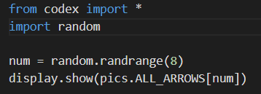
Mission Activity #1
DO THIS:
Start a new file named
Game_Spinner
Import the codex module
Import the random module
Assign a random number to a variable
Use display.show() to display the list item at the number
  Use CodeTrek if you need help

Slide 6

Which arrows
In previous missions, you learned about random number and lists.
Answer 2 quiz questions about random numbers and the list index
CODEX
QUIZ

Slide 7
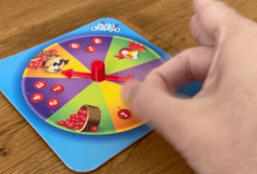
Objective #2: Click to flick
Some board games have a game spinner with an arrow that you flick.
You will use a button press instead of a flick to “spin” your arrow.
Make your game spinner arrow change whenever you press either BTN_A or BTN_B.

Slide 8
Objective #2: Click to flick
Two things to learn:
Current button press
  Mission 4
Logical operators

Slide 9
Objective #2: Click to flick
Current button press
In Mission 4, you learned about buttons.is_pressed()
It checks right then to see if a button is pressed and will do something if it is.
For this program, you will use buttons.is_pressed() for both A and B buttons

Slide 10


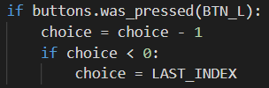
Objective #2: Click to flick
Logical operators
In earlier missions, you used a condition in an if statement

Slide 11
Objective #2: Click to flick
Logical operators
What if you have two conditions you want to check at the same time?
For example:
  Button A pressed OR button B pressed
Use a logical operator!
They combine two conditions together
LOGICAL OPERATORS:
AND
  two conditions must be true
OR
  one of two conditions (or both) must be true

Slide 12
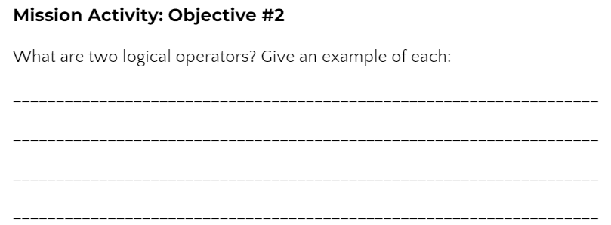
Mission Activity #2
DO THIS:
Go to your Mission Log and write down examples of logical operators.

Slide 13
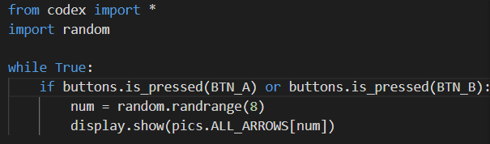
Mission Activity #2
Apply these concepts to make the spinner go
DO THIS:
Add a while True loop
Add an if statement using buttons.is_pressed and check for BTN_A or BTN_B.
Be careful with the indenting!
Test the code by pressing Button A and Button B at different times.

Slide 14
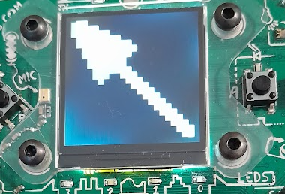
Objective #3: Fun Functions
The arrow appears, but it isn’t very realistic.
You want to see some spinning action before the arrow stops.
You will add some animation
This could add several lines of code to your program

Slide 15
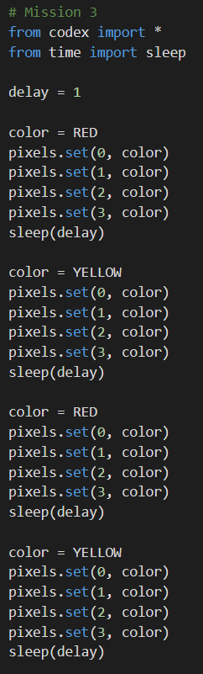
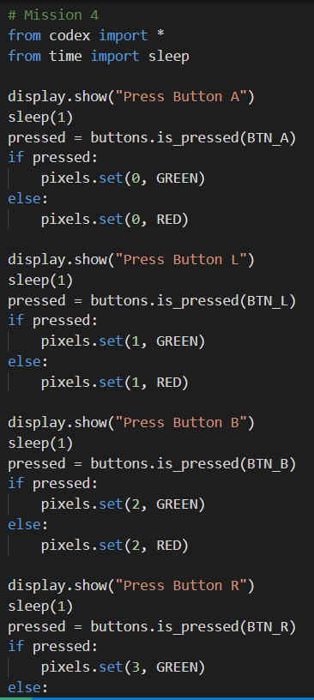
Objective #3: Fun Functions
Adding several lines of code to your program makes it harder to read
You have already written programs with several lines of code
  Mission 3 and 4 are fairly long
  Your remixes may have a lot of code as well

Slide 16
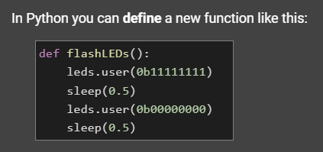
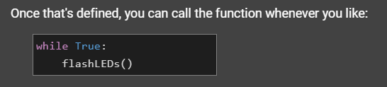
Objective #3: Fun Functions
You can take chunks of code from the main program and make them into functions!

Slide 17
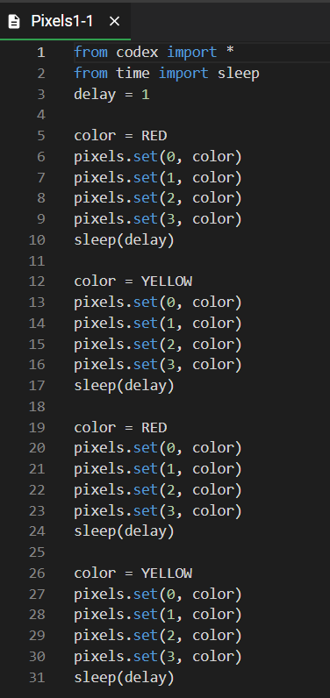
Functions in Mission 3
Take a look at code from Mission 3
In this example, some code is repeated
These are places to make functions

Slide 18
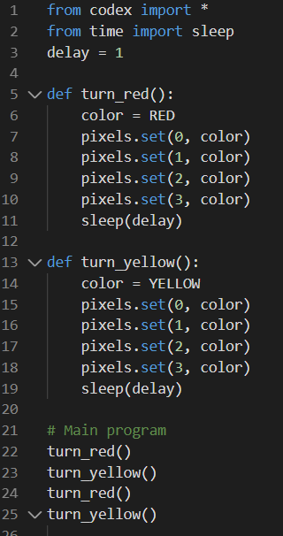
Call a function
Create a function for each color
Delete any extra code
Call the functions in the order you want to run them
Do you see how much easier the code is to read? And it is shorter!

Slide 19

Objective #3: Fun Functions
You can create a function any time you want to keep the code easy to read.
The keyword means “define function”
Use a colon (:) at the end of the line, just like a while loop and an if statement – you are making a block of code
Indent the lines of code inside the function

Slide 20

Objective #3: Fun Functions
A function must be defined before it can be called.
Define your function above the while True loop
Move the code from the while loop to the function
Call the function in the while loop
  NOTE: a function call DOES NOT have the word “def” or a colon (:)

Slide 21
Mission Activity #3
DO THIS:
Define the function show_random_arrow()
Call the function show_random_arrow()
Follow the steps from the two previous slides, or use CodeTrek for help
Test your program by pressing both Button A and Button B at different times. It should work just the same as before, but with a function.

Slide 22
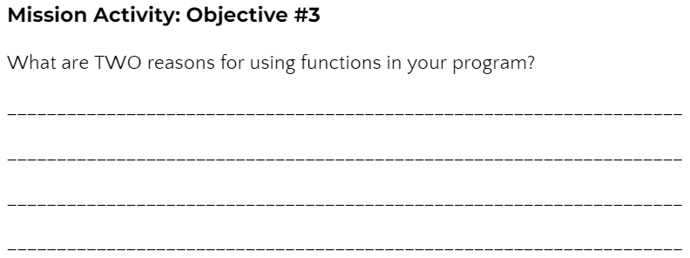
Mission Activity #3
DO THIS:
After objective 3 is completed, the message displayed gives another reason for using functions.
Go to your Mission Log and answer the question about functions

Slide 23
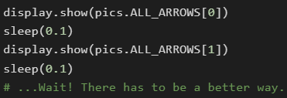
Objective #4: Animation
You added a function, but your code still does the same thing – displays one arrow.
You will create an animation by going through the arrows in the list in order – quickly!
There are 8 arrows in the list
You could call each arrow with a short delay:

Slide 24
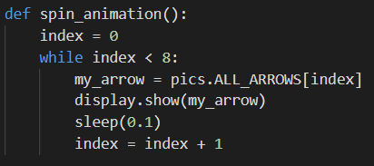
Objective #4: Animation
Or, you can use a loop!
Not an infinite loop
(like while True) but a
loop that goes 8 times.

Slide 25
Objective #4: Animation
This loop counts how many times it is executed
The variable index is used both to count the loops and to display an arrow in the list
The variable index must be incremented inside the loop
  You learned about this in Mission 7

Slide 26
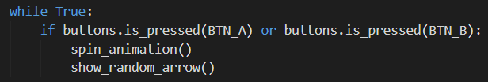
Mission Activity #4
DO THIS:
Import sleep from the time module
Define the function spin_animation
  Use the previous slide for help
Call the function spin_animation just before you call show_random_arrow()
Test your code by pressing both Button A and Button B

Slide 27
Indented?
During this mission you have learned about indenting, loops and functions.
Answer 3 quiz questions about the Objectives 1-4
CODEX
QUIZ

Slide 28
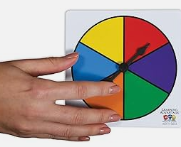
Objective #5: Style points - physics part 1
The game spinner is nice – but still not very realistic.
It needs to spin more than one time around
It needs to gradually slow down before
stopping
Let’s start with the first problem –
making the spinner go more than
one time around

Slide 29
Objective #5: Style points - physics part 1
Right now the spinner goes one time because the loop checks for index < 8.
What if it checked for a number larger than 8?
You can tell the function how many times to loop
When you give the function information, it is called a parameter

Slide 30
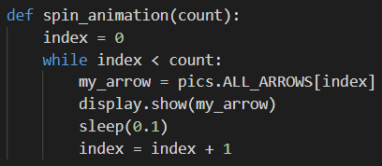
Objective #5: Style points - physics part 1
A Parameter
The parameter is shown in the parenthesis
The function uses the parameter, or data, to complete its task.

Slide 31

Objective #5: Style points - physics part 1
An argument
When you call a function, you can supply values for those parameters.
Values you pass when calling a function are called arguments.
An argument can be a variable or a literal value.

Slide 32
Mission Activity #5
DO THIS:
Add the parameter count to the spin_animation() function
Use count in the while loop
Call spin_animation() with the argument 8
Follow the steps from the two previous slides, or use CodeTrek for help

Slide 33
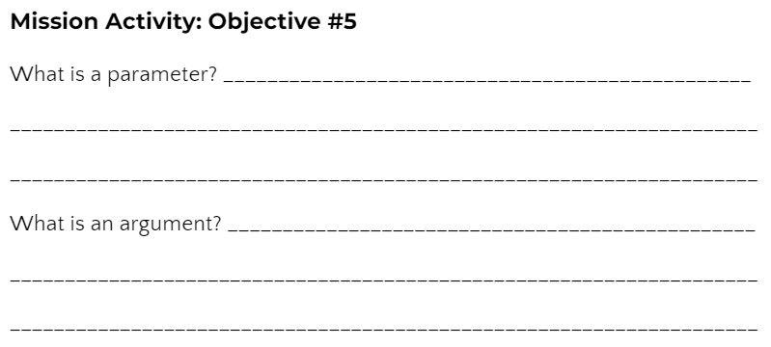
Mission Activity #5
DO THIS:
Go to your Mission Log and answer the questions about parameters and arguments

Slide 34

Objective #6: Unruly index
Time to increase the number of spins. Can you make the arrow spin longer than 8 times?
Change the argument in the function call to 30
Run the code and press BTN_A
Do you get an error?
Let’s find out why, and how to fix it

Slide 35


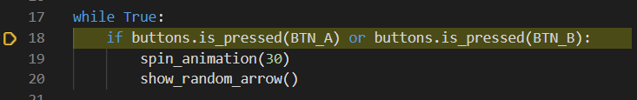
Mission Activity #6
DO THIS:
Use the debugger
Step in the program
When you see this line, press BTN_A while pressing
< continued on next slide>

Slide 36

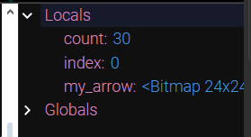
Mission Activity #6
DO THIS:
Open the console
Watch the local variables as you continue to step in the code
What is the value of index when the error occurs?
Go to your Mission Log and answer the question.

Slide 37
Objective #7: Tame the unruly index
Did you find the error?
The list has eight arrows
The index values are 0 through 7
When the index value is 8, it is past the end of the list
Solve this problem by using another variable for the loop, instead of index.

Slide 38

Objective #7: Tame the unruly index
You will still increment index in the loop.
Do you remember in Mission 7 you scrolled through a list?
You will use the same wrapping code:

Slide 39
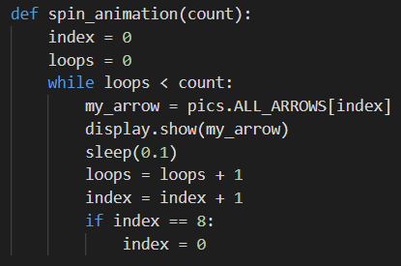
Objective #7: Tame the unruly index
Now you can use a different variable to count the loops:
Remember to increment the loops variable inside the loop

Slide 40
Mission Activity #7
DO THIS:
Define the loops variable
Compare loops to count in the while loop
Increment loops
Write code to wrap index
Follow the steps from the two previous slides, or use CodeTrek for help

Slide 41
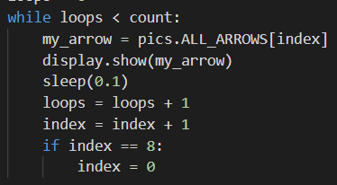
Objective #8: Style points - physics part 2
Spin down. For a more realistic spin, you can make the arrows gradually slow down before stopping.
Right now the same amount of time is used: sleep(0.1)
Use the variable delay instead of a literal value!
Increment delay by a little bit

Slide 42
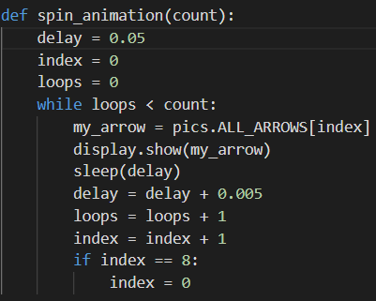
Mission Activity #8
DO THIS:
Define the delay variable
Use delay in sleep()
Increment delay

Slide 43
Post-Mission Reflection
Read the “completed mission” message and click to complete the mission
Complete the Mission 9 Log

Slide 44
Clearing your CodeX
Go to FILE -- BROWSE FILES
Select the “Clear” file and open it
Run the program to clear the CodeX

